Slide 1

Mining Sparse Representations: Formulations, Algorithms, and Applications
Jun Liu, Shuiwang Ji, and Jieping Ye
Computer Science and Engineering
The Biodesign Institute
Arizona State University

Slide 2
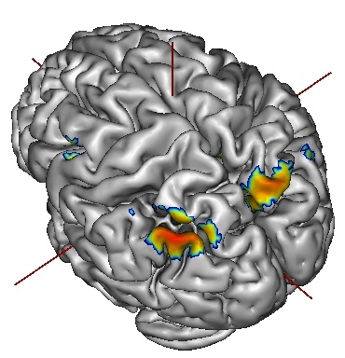
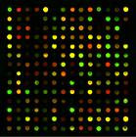
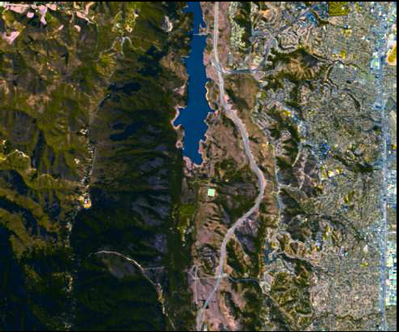
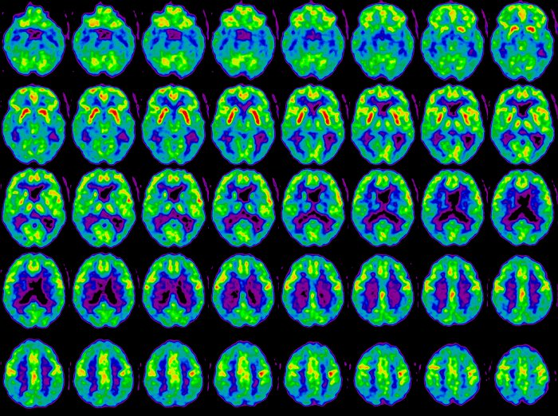
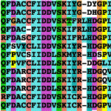
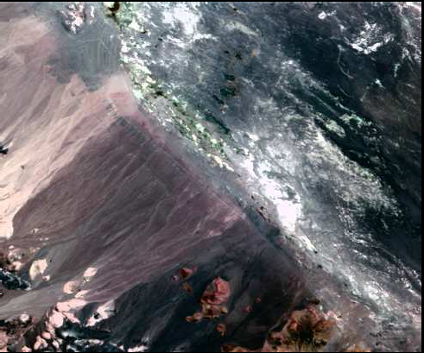
Mining High-Dimensional Data

Slide 3
Dimensionality Reduction
Dimensionality reduction algorithms
Feature extraction
Feature selection
We focus on sparse learning in this tutorial
Embed dimensionality reduction into data mining tasks
Flexible models for complex feature structures
Strong theoretical guarantee
Empirical success in many applications
Recent progress on efficient implementations
features
new features
Original data
reduced data
Data points
SIAM Data Mining 2007 Tutorial (Yu, Ye, and Liu):
“Dimensionality Reduction for Data Mining - Techniques, Applications, and Trends”

Slide 4
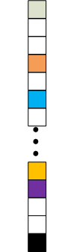
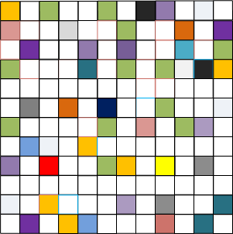
What is Sparsity?
Many data mining tasks can be represented using a vector or a matrix.
“Sparsity” implies many zeros in a vector or a matrix.

Slide 5
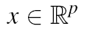
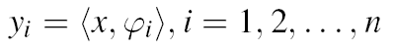
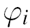
Motivation: Signal Acquisition (1)
Wish to acquire a digital object from n measurements:
Waveforms
Dirac delta functions (spikes)
y is a vector of sampled values of x in the time or space domain
Indicator functions of pixels
y is the image data typically collected by sensors in a digital camera
Sinusoids
y is a vector of Fourier coefficients (e.g., MRI)
Is accurate reconstruction possible from n <<p measurements only?
Few sensors
Measurements are very expensive
Sensing process is slow
Notes:
Original megapixel image with pixel values in the range [0,255] and its wavelet transform coefficients (arranged
in a random order for enhanced visibility). Relatively few wavelet coefficients capture most of the signal energy. Many
such images are highly compressible and the rightmost image shows the reconstruction obtained by zeroing out all the
coefficients in the wavelet expansion but the 25,000 largest (pixel values below 0 and above 255 are set to 0 and 255
respectively). The difference with the original picture is hardly noticeable.

Slide 6
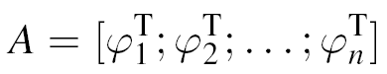
Motivation: Signal Acquisition (2)
Conventional wisdom: reconstruction is impossible
Number of measurements must match the number of unknowns
y x
If x is known to be sparse, i.e., most entries are zero, then with a large probability we can recover x exactly by solving a linear programming.
n×1 measurements
p×1 signal
If n<<p, the system is underdetermined.
Notes:
Original megapixel image with pixel values in the range [0,255] and its wavelet transform coefficients (arranged
in a random order for enhanced visibility). Relatively few wavelet coefficients capture most of the signal energy. Many
such images are highly compressible and the rightmost image shows the reconstruction obtained by zeroing out all the
coefficients in the wavelet expansion but the 25,000 largest (pixel values below 0 and above 255 are set to 0 and 255
respectively). The difference with the original picture is hardly noticeable.

Slide 7
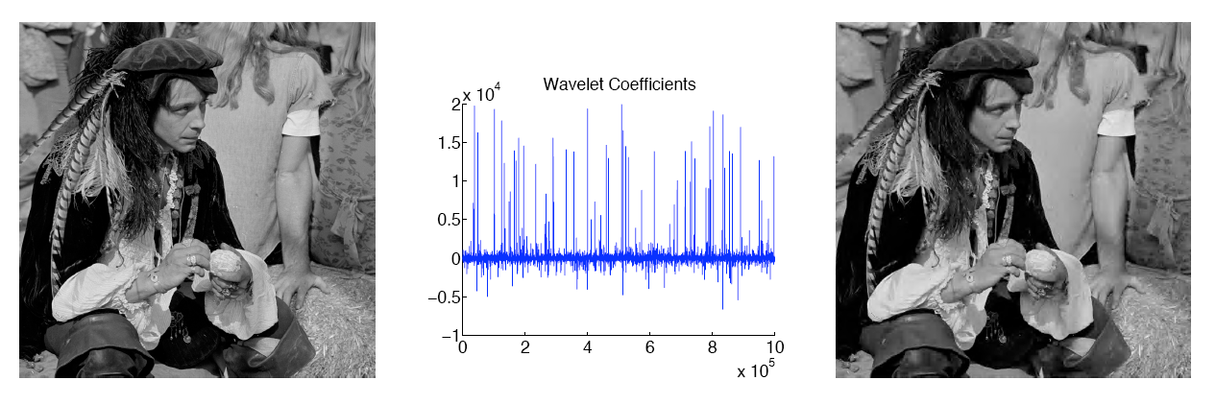
Motivation: Signal Acquisition (3)
Many natural signals are sparse or compressible in the sense that they have concise representations when expressed in the proper basis
Megapixel image represented as 2.5% largest wavelet coefficients
(Candes and Wakin, 2008)
Notes:
Original megapixel image with pixel values in the range [0,255] and its wavelet transform coefficients (arranged
in a random order for enhanced visibility). Relatively few wavelet coefficients capture most of the signal energy. Many
such images are highly compressible and the rightmost image shows the reconstruction obtained by zeroing out all the
coefficients in the wavelet expansion but the 25,000 largest (pixel values below 0 and above 255 are set to 0 and 255
respectively). The difference with the original picture is hardly noticeable.

Slide 8
Sparsity
Dominant modeling tool
Genomics
Genetics
Signal and audio processing
Image processing
Neuroscience (theory of sparse coding)
Machine learning
Data mining
…
Sparsity in data mining
Regression
Classification
Multi-Task Learning
Collaborative Filtering
Network Construction

Slide 9
Sparse Learning Models
Let x be the model parameter to be estimated. A commonly employed model for estimating x is
min loss(x) + λ×penalty(x) (1)
(1) is equivalent to the following model:
min loss(x)
s.t. penalty(x) ≤ z (2)
Least squares
Logistic loss
Hinge loss
…
Zero norm is the natural choice
The number of nonzero elements of x
Not a valid norm, nonconvex, NP-hard

Slide 10

The L₁ Norm Penalty
In this tutorial, we focus on sparse learning based on L₁ and its extensions:
penalty(x)=||x||₁=∑_{i}|x_{i}|
Valid norm
Convex
Computationally tractable
Sparsity induced norm
Theoretical properties
Various Extensions
min loss(x) + λ ||x||₀
min loss(x) + λ ||x||₁

Slide 11
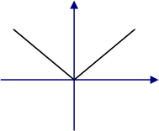
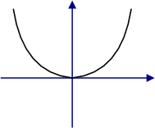
Why does L₁ Induce Sparsity?
0.5×(x-v)² + λ|x|
0.5×(x-v)² + λx²
If v≥ λ, x=v- λ
If v≤ -λ, x=v+λ
Else, x=0
x=v/(1+2 λ)
Nondifferentiable at 0
Differentiable at 0
Analysis in 1D (comparison with L₂)
Notes:
Non-differentiability is key for inducing sparsity
11

Slide 12
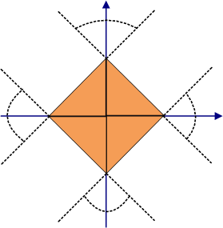
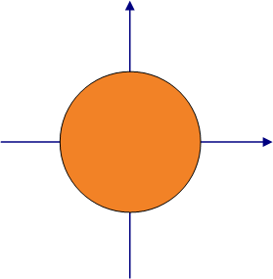
Why does L₁ Induce Sparsity?
min loss(x)
s.t. ||x||₁ ≤1
min 0.5||x-v||²
s.t. ||x||₁ ≤1
min loss(x)
s.t. ||x||₂ ≤1
min 0.5||x-v||²
s.t. ||x||₂ ≤1
Sparse
Understanding from the projection
Notes:
12

Slide 13
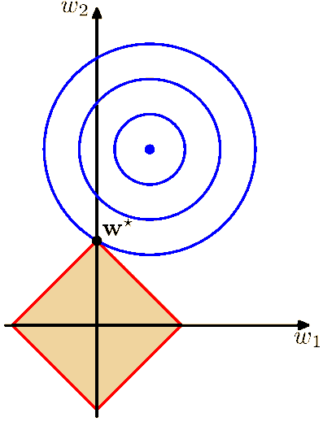
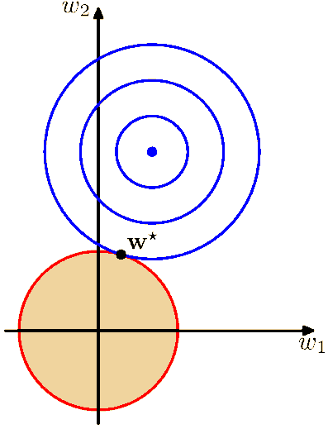
Why does L₁ Induce Sparsity?
min loss(x)
s.t. ||x||₁ ≤1
min loss(x)
s.t. ||x||₂ ≤1
(Bishop, 2006, Hastie et al., 2009)
Understanding from constrained optimization
Notes:
Non-differentiability is key for inducing sparsity
13

Slide 14
Outline
Sparse Learning Models
Sparsity via L₁
Sparsity via L₁/L_{q}
Sparsity via Fused Lasso
Sparse Inverse Covariance Estimation
Sparsity via Trace Norm
Implementations and the SLEP Package
Trends in Sparse Learning

Slide 15
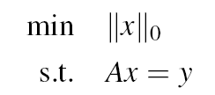
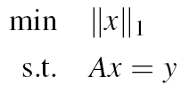
Compressive Sensing (Donoho, 2004; Candes and Tao, 2008; Candes and Wakin, 2008)
x
y
A
x is sparse
p>>n
A is a measurement matrix satisfying certain conditions
=
×
…
n×1
n×p
p×1
NP hard
P₀
P₁

Slide 16
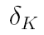
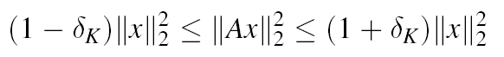
Sparse Recovery
P₀
P₁
The measurement matrix A satisfies the K-restricted isometry property with constant if is the smallest number satisfying
for every K-sparse vector x.

Slide 17
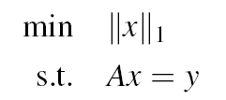
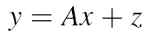
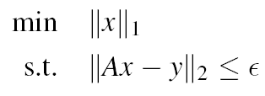
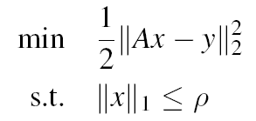
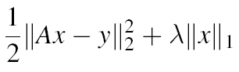
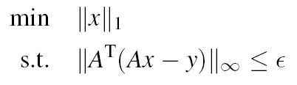
Extensions to the Noisy Case
noise
Basis pursuit De-Noising
(Chen, Donoho, and Saunders, 1999)
Lasso (Tibshirani, 1996)
Regularized counterpart of Lasso
Dantzig selector (Candes and Tao, 2007)

Slide 18
Lasso (Tibshirani, 1996)
y
y
A
z
=
×
+
…
n×1
n×p
n×1
p×1
Simultaneous feature selection and regression

Slide 19
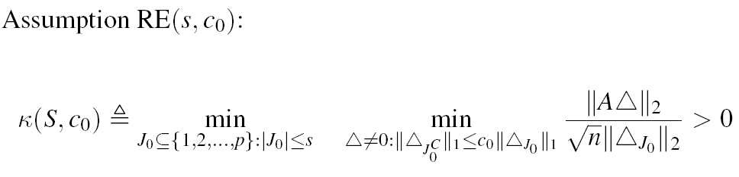
Lasso Theory (Bickel, Ritov, and Tsybakov, 2009)
Restricted eigenvalue conditions

Slide 20
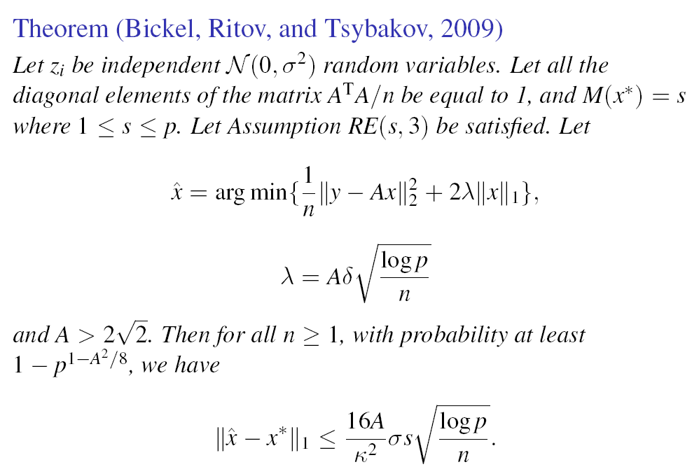

Slide 21
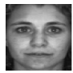
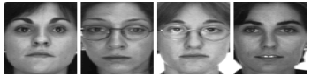
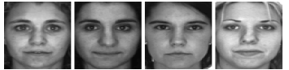
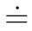
Application: Face Recognition (Wright et al. 2009)
test image
training images
…
…
×
Use the computed sparse coefficients for classification

Slide 22
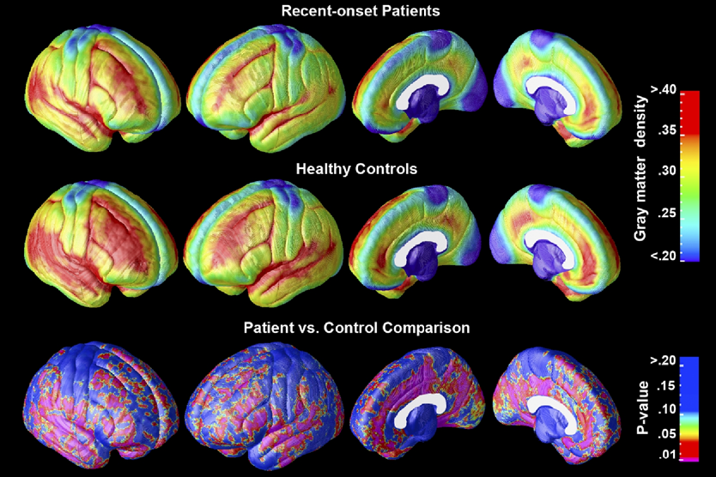
Application: Biomedical Informatics (Sun et al. 2009)
Elucidate a Magnetic Resonance Imaging-Based Neuroanatomic Biomarker for Psychosis

Slide 23
Application: Bioinformatics
Genome-wide association analysis by Lasso penalized logistic regression. Bioinformatics, 2009.
Detecting disease causing genes by LASSO-Pattern search algorithm. BMC Proceedings, 2007.
A simple and efficient algorithm for gene selection using sparse logistic regression. Bioinformatics, 2003.

Slide 24
Outline
Sparse Learning Models
Sparsity via L₁
Sparsity via L₁/L_{q}
Sparsity via Fused Lasso
Sparse Inverse Covariance Estimation
Sparsity via Trace Norm
Implementations and the SLEP Package
Trends in Sparse Learning

Slide 25
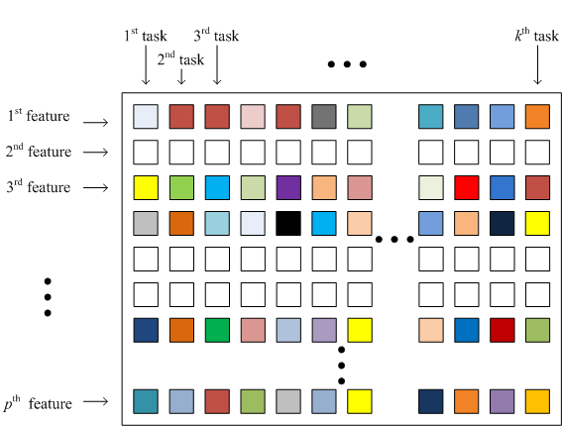
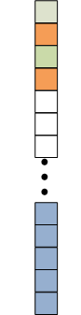
From L₁ to L₁/L_{q} (q>1)?
L₁/L_{q}
L₁
L₁/L_{q}
q norm
q norm
1 norm
q norm
Most existing work focus on q=2, ∞

Slide 26
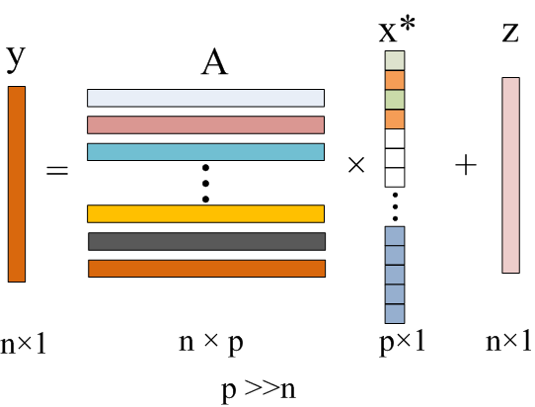
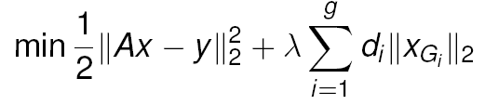
Group Lasso (Yuan and Lin, 2006)

Slide 27
Group Feature Selection
group
A
T
C
G
1 | 0 | 0 | 0
0 | 1 | 0 | 0
0 | 0 | 1 | 0
0 | 0 | 0 | 1
brain region
functional group
categorical variable
Notes:
The prediction of short DNA motifs plays an important role in many areas of computational
biology. Gene finding algorithms such as GENIE (Burge and Karlin, 1997) often rely on the
prediction of splice sites. Splice sites are the regions between coding (exons) and non-coding
(introns) DNA segments. The 5 end of an intron is called a donor splice site and the 3 end an
acceptor splice site. A donor site whose first two intron positions are the letters ‘GT’ is called
canonical, whereas an acceptor site is called canonical if the corresponding intron ends with
‘AG’. An overview of the splicing process and of some models that are used for detecting splice
sites can be found in Burge (1998).

Slide 28
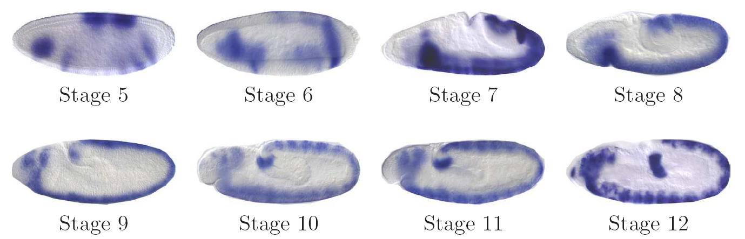
Developmental Stage Annotation (1)
Drosophila embryogenesis is divided into 17 stages (1-17)
Comparison of spatial patterns is the most meaningful when embryos are in the same time.
Images from high-throughput study are annotated with stage ranges
BDGP (1-3, 4-6, 7-8, 9-10, 11-12, 13-)
Fly-FISH (1-3, 4-5, 6-7, 8-9, 10-)
1 | 2 | 3 | 4 | 5 | 6 | 7 | 8 | 9 | 10 | 11 | 12 | 13 | 14 | 15 | 16 | 17
25 | 40 | 15 | 50 | 40 | 10 | 10 | 30 | 40 | 60 | 120 | 120 | 60 | 60 | 100 | 360 | 720

Slide 29

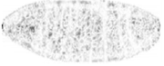

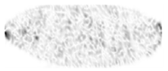
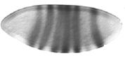

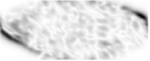

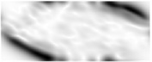


Developmental Stage Annotation (2)
Group i
Group j
…
…
A group of 24 features is associated with a single region of the image.
Group selection

Slide 30
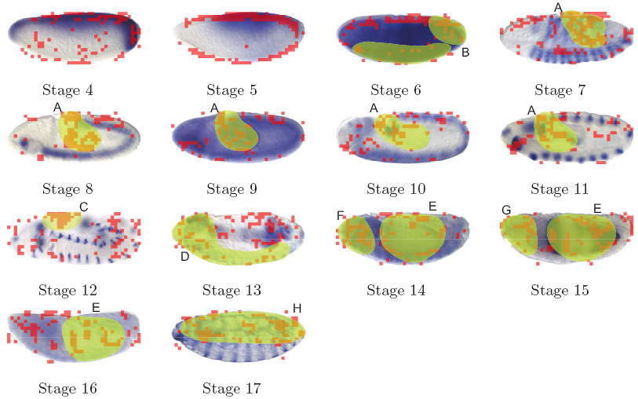
Developmental Stage Annotation (3)

Slide 31
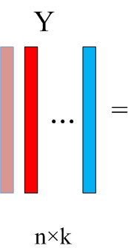
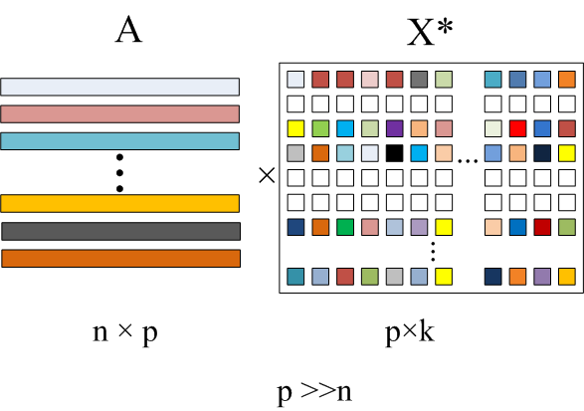
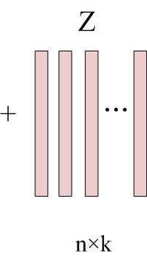

Multi-Task/Class Learning via L₁/L_{q}

Slide 32

Writer-specific Character Recognition (Obozinski, Taskar, and Jordan, 2006)
Letter data set:
1) The letters are from more than 180 different writers
2) It has 8 tasks for discriminating letter c/e, g/y, g/s, m/n, a/g, i,/j, a/o. f/t, and h/n
The letter ‘a’ written by 40 different people
Notes:
We used letters from a handwritten words data set by Rob Kassel at the MIT Spoken Language
Systems Group.3 This data set contains samples from more than 180 different writers (see Fig. 4
(Left) for examples). For each writer, however, the number of examples of each letter is rather small:
between 4 and 30 depending on the letter.
We built binary classifiers that discriminate between pairs of letters. Specifically we concentrated
on the pairs of letters that are di±cult to distinguish when written by hand.
Pooled: The writers are ignored and all the letters of both classes to be discriminated
are pooled.
Independent: For each writer an independent L1-regularized logistic re-
gression is learned.
L1/L1: The objective function is Eqn. (1) with the log-loss and so the tasks are
tied only by the regularization coefficient.

Slide 33



Writer-specific Character Recognition (Obozinski, Taskar, and Jordan, 2006)
Samples of the letters s and g for one writer

Slide 34

Visual Category Recognition (Quattoni et al., 2009)
Images on the Reuters website have associated story or topic labels, which correspond to different stories in the news.
An image can belong to one or more stories.
Binary prediction of whether an image belonged to one of the 40 most frequent stories.
Notes:
For this experiments we collected a dataset from the Reuters news-website. Images on the Reuters
website have associated story or topic labels, which correspond to different stories in the news.
There were a total of 25,589 images and 316 stories, an image can belong to one or more stories.
The experiments involved the binary prediction of whether an image belonged to one of the 40 most
frequent stories, these are all the stories for which we had at least 80 positive images in the training
partition. Story examples are: Golden Globes, Australian Open, Danish Cartoons or Afghanistan.
We partitioned the data into four sets: 5,000 images were used as unlabeled data to compute an
image representation, 5,000 images were reserved as validation data, and 10,589 images as training
data. The remaining 5,000 images where used for testing. For each of the 40 most frequent topics
we created multiple training sets of different sizes, n = {15, 30, 60, 120, 240}: each training set
contained n positive examples and 2n negative examples. All examples were randomly sampled
from the supervised training data. We performed 10 runs of the experiments by randomizing the
selection of training examples.

Slide 35

Visual Category Recognition (Quattoni et al., 2009)

Slide 36
Outline
Sparse Learning Models
Sparsity via L₁
Sparsity via L₁/L_{q}
Sparsity via Fused Lasso
Sparse Inverse Covariance Estimation
Sparsity via Trace Norm
Implementations and the SLEP Package
Trends in Sparse Learning

Slide 37





Fused Lasso (Tibshirani et al., 2005; Tibshirani and Wang, 2008; Friedman et al., 2007)
L₁
Fused Lasso

Slide 38



Fused Lasso

Slide 39


Application: Arracy CGH Data Analysis (Tibshirani and Wang, 2008)
Comparative genomic hybridization (CGH)
Measuring DNA copy numbers of selected genes on the genome
In cells with cancer, mutations can cause a gene to be either deleted or amplified
Array CGH profile of two chromosomes of breast cancer cell line MDA157.
Notes:
In cells with cancer, mutations can cause a gene to be either deleted from the chromosome or amplified, that is, there are extra DNA copies of the gene.
cDNA microarray CGH was profiled across 6691
mapped human genes in 44 breast tumor samples and 10 breast cancer cell lines.
Array CGH profile of 8 chromosomes of breast cancer cell line MDA157. Panels in the same row are for the
same chromosome. The integers at the beginning of each row are chromosome indexes. The dark black line in each panel represents the estimated copy number of a particular method.
The ArrayCGH (Array comparative genomic hybridization)
is a micro-array based technology that can detect genomic copy
number variation (CNV) at different locations along the genome.
Each measurement (feature) is the log ratio of CNV, and adjacent
features correspond to adjacent locations along the genome.

Slide 40

Application to Unordered Features
Features in some applications are not ordered, e.g., genes in a microarray experiment have no pre-specified order
Estimate an order for the features using hierarchical clustering
The leukaemia data [Golub et al. 1999]
7129 genes and 38 samples: 27 in class 1 (acute lymphocytic leukaemia) and 11 in class 2 (acute mylogenous leukaemia)
A test sample of size 34
Notes:
The ArrayCGH (Array comparative genomic hybridization)
is a micro-array based technology that can detect genomic copy
number variation (CNV) at different locations along the genome.
Each measurement (feature) is the log ratio of CNV, and adjacent
features correspond to adjacent locations along the genome.

Slide 41
Outline
Sparse Learning Models
Sparsity via L₁
Sparsity via L₁/L_{q}
Sparsity via Fused Lasso
Sparse Inverse Covariance Estimation
Sparsity via Trace Norm
Implementations and the SLEP Package
Trends in Sparse Learning

Slide 42


Sparse Inverse Covariance Estimation
Undirected graphical model
(Markov Random Field)
The pattern of zero entries in the inverse covariance matrix of a multivariate normal distribution corresponds to conditional independence restrictions between variables.
Notes:
If the ijth component of (inverse covariance) is zero, then variables i and j are conditionally independent, given the other variables.

Slide 43

The SICE Model
Sparsity
Log-likelihood
When S is invertible, directly maximizing
the likelihood gives
X=S⁻¹
Notes:
If the ijth component of (inverse covariance) is zero, then variables i and j are conditionally, independent, given the other variables.

Slide 44
Network Construction
Biological network
Social network
Brain network
Equivalent matrix representation
Sparsity: Each node is linked to a small
number of neighbors in the network.
Notes:
The 300 experiment compendium contains n =253 samples with p = 6136 variables. We set λ = 0.0313, which leads to all but 270
of the variables are estimated to be independent from all the rest.
The second figure shows a cluster of genes that is unconnected to
the remaining genes in this estimate. According to Gene Ontology [see Consortium, 2000],
these genes are associated with iron homeostasis. The probability that a gene has been false
included in this cluster is at most 0.05.
44

Slide 45
The Monotone Property (1)
Monotone Property
Let and be the sets of all the connectivity components of with and respectively.
If , then .
Intuitively, if two nodes are connected (either directly or indirectly) at one level of sparseness, they will be connected at all lower levels of sparseness.

Slide 46

The Monotone Property (2)
AD
NC

Slide 47

Example: Senate Voting Records Data (2004-06) (Banerjee et al., 2008)
Democratic senators
Republican senators
Chafee (R, RI) has only Democrats as his neighbors, an observation that supports media statements made by and about Chafee during those years.

Slide 48
Example: Senate Voting Records Data (2004-06) (Banerjee et al., 2008)
Democratic senators
Republican senators
Senator Allen (R, VA) unites two otherwise separate groups of Republicans and also provides a connection to the large cluster of Democrats through Ben Nelson (D, NE), which also supports media statements made about him prior to his 2006 re-election campaign.

Slide 49
Brain Connectivity using Neuroimages (1)
AD is closely related to the alternations of the brain network, i.e., the connectivity among different brain regions
AD patients have decreased hippocampus connectivity with prefrontal cortex (Grady et al. 2001) and cingulate cortex (Heun et al. 2006).
Brain regions are moderately or less inter-connected for AD patients, and cognitive decline in AD patients is associated with disrupted functional connectivity in the brain
Celone et al. 2006, Rombouts et al. 2005, Lustig et al. 2006.
PET images (49 AD, 116 MCI, 67 NC)
http://www.loni.ucla.edu/Research/Databases/

Slide 50
Brain Connectivity using Neuroimages (2)

Slide 51
Brain Connectivity using Neuroimages (3)
The temporal lobe of AD has significantly less connectivity than NC.
The decrease in connectivity in the temporal lobe of AD, especially between the Hippocampus and other regions, has been extensively reported in the literature.
The temporal lobe of MCI does not show a significant decrease in connectivity, compared with NC.
The frontal lobe of AD has significantly more connectivity than NC.
Because the regions in the frontal lobe are typically affected later in the course of AD, the increased connectivity in the frontal lobe may help preserve some cognitive functions in AD patients.
frontal, parietal, occipital, and temporal lobes in order
AD MCI NC

Slide 52
Outline
Sparse Learning Models
Sparsity via L₁
Sparsity via L₁/L_{q}
Sparsity via Fused Lasso
Sparse Inverse Covariance Estimation
Sparsity via Trace Norm
Implementations and the SLEP Package
Trends in Sparse Learning

Slide 53
Collaborative Filtering
Items
 | ? | ? | ? | ? | ? |  | ? | ? | ?
? | ? |  | ? |  | ? | ? | ? | ? | ?
? | ? | ? | ? | ? | ? | ? | ? |  | ?
? | ? | ? |  | ? | ? | ? | ? | ? | ?
 | ? | ? | ? | ? |  | ? | ? | ?
? |  | ? | ? | ? | ? | ? | ? |  | ?
? | ? | ? | ? | ? |  | ? | ? | ? | ?
? | ? | ? |  | ? | ? | ? | ? |  | ?
Customers
Customers are asked to rank items
Not all customers ranked all items
Predict the missing rankings (98.9% is missing)

Slide 54
The Netflix Problem
Movies
 | ? | ? | ? | ? | ? |  | ? | ? | ?
? | ? |  | ? |  | ? | ? | ? | ? | ?
? | ? | ? | ? | ? | ? | ? | ? |  | ?
? | ? | ? |  | ? | ? | ? | ? | ? | ?
 | ? | ? | ? | ? |  | ? | ? | ?
? |  | ? | ? | ? | ? | ? | ? |  | ?
? | ? | ? | ? | ? |  | ? | ? | ? | ?
? | ? | ? |  | ? | ? | ? | ? |  | ?
Users
About a million users and 25,000 movies
Known ratings are sparsely distributed
Predict unknown ratings
Preferences of users are determined by a small number of factors → low rank

Slide 55
Matrix Rank
The number of independent rows or columns
The singular value decomposition (SVD):
}
rank
=
×
×

Slide 56




The Matrix Completion Problem

Slide 57
Other Low-Rank Problems
Multi-Task/Class Learning
Image compression
System identification in control theory
Structure-from-motion problem in computer vision
Low rank metric learning in machine learning
Other settings:
low-degree statistical model for a random process
a low-order realization of a linear system
a low-order controller for a plant
a low-dimensional embedding of data in Euclidean space

Slide 58
Two Formulations for Rank Minimization
min rank(X)
subject to loss(X)≤ ε
min loss(X) + λ*rank(X)
Rank minimization is NP-hard

Slide 59


Trace Norm (Nuclear Norm)
trace norm ⇔ 1-norm of the vector of singular values
trace norm is the convex envelope of the rank function over the unit ball of spectral norm ⇒ a convex relaxation

Slide 60
Two Formulations for Trace Norm
min loss(X) + λ×||X||
min ||X||
subject to loss(X)≤ ε
*
*
Trace norm minimization is convex
Can be solved by
Semi-definite programming
Gradient-based methods

Slide 61
Semi-definite programming (SDP)
s.t.
s.t.
SDP is convex, but computationally expensive
Many recent efficient solvers:
Singular value thresholding (Cai et al, 2008 )
Fixed point method (Ma et al, 2009)
Accelerated gradient descent (Toh & Yun, 2009, Ji & Ye, 2009)

Slide 62

Fundamental Questions
Can we recover a matrix M of size n1 by n2 from m sampled entries, m << n1×n2?
In general, it is impossible.
Surprises (Candes & Recht’08):
Can recover matrices of interest from incomplete sampled entries
Can be done by convex programming

Slide 63


Theory of Matrix Completion (Candes and Recht, 2008)
(Candes and Tao, 2010)

Slide 64
Outline
Sparse Learning Models
Sparsity via L₁
Sparsity via L₁/L_{q}
Sparsity via Fused Lasso
Sparse Inverse Covariance Estimation
Sparsity via Trace Norm
Implementations and the SLEP Package
Trends in Sparse Learning

Slide 65
Optimization Algorithms
min f(x)= loss(x) + λ×penalty(x)
Smooth and convex
Least squares
Logistic loss
…
Convex but nonsmooth
L₁
L₁/L_{q}
Fused Lasso
Trace Norm
…
Smooth Reformulation – general solver
Coordinate descent
Subgradient descent
Gradient descent
Accelerated gradient descent
…
Notes:
Next, we introduce the first five methods.

Slide 66


Smooth Reformulations: L₁
Linearly constrained quadratic programming

Slide 67


Smooth Reformulation: L₁/L₂
Second order cone programming

Slide 68


Smooth Reformulation: Fused Lasso
Linearly constrained quadratic programming

Slide 69
Summary of Smooth Reformulations
Advantages:
Easy use of existing solvers
Fast and high precision for small size problems
Disadvantages:
Does not scale well for large size problems due to many additional variables and constraints introduced
Does not utilize well the “structure” of the nonsmooth penalty
Not applicable to all the penalties discussed in this tutorial, say, L₁/L₃.
Notes:
In the large scale case, we usually prefer the first-order methods, those using the (sub)gradient and functional value only.

Slide 70



Coordinate Descent (Tseng, 2002)

Slide 71

Coordinate Descent: Example (Tseng, 2002)

Slide 72

Coordinate Descent: Convergent? (Tseng, 2002)
If f(x) is smooth and convex, then the algorithm is guaranteed to converge.
If f(x) is nonsmooth, the algorithm can get stuck.

Slide 73
Coordinate Descent: Convergent? (Tseng, 2002)
If f(x) is smooth and convex, then the algorithm is guaranteed to converge.
If f(x) is nonsmooth, the algorithm can get stuck.
If the nonsmooth part is separable, convergence is guaranteed.
min f(x)= loss(x) + λ×penalty(x)
penalty(x)=||x||₁

Slide 74
Coordinate Descent
Can x^{new} be computed efficiently?
min f(x)= loss(x) + λ×penalty(x)
penalty(x)=||x||₁
loss(x)=0.5×||Ax-y||²₂

Slide 75
CD in Sparse Representation
Lasso
(Fu, 1998; Friedman et al., 2007)
L1/L_{q} regularized least squares & logistic regression (Yuan and Lin, 2006, Liu et al., 2009; Argyriou et al., 2008; Meier et al., 2008)
Sparse inverse covariance estimation
(Banerjee et al., 2008; Friedman et al., 2007)
Fused Lasso and Fused Lasso Signal Approximator
(Friedman et al., 2007; Hofling, 2010)
CD can get stuck for fused Lasso

Slide 76
Summary of CD
Advantages:
Easy implementation, especially for the least squares loss
Can be fast, especially when the solution is very sparse
Disadvantages:
No convergence rate
Can be hard to derive x^{new} for general loss
Can get stuck when the penalty is non-separable

Slide 77



Subgradient Descent (Nemirovski, 1994; Nesterov, 2004)
Repeat
Until “convergence”
Subgradient: one element in the subdifferential set

Slide 78

Subgradient Descent: Convergent? (Nemirovski, 1994; Nesterov, 2004)
Repeat
Until “convergence”
If f(x) is Lipschitz continuous with constant L(f), and the step size is set as follows
then, we have
Notes:
D: the diameter of the domain G.

Slide 79
SD in Sparse Representation
L₁ constrained optimization (Duchi et al., 2008)
L₁/L∞ constrained optimization (Quattoni et al., 2009)
Advantages:
Easy implementation
Guaranteed global convergence
Disadvantages
It converges slowly
It does not take the structure of the non-smooth term into consideration

Slide 80




Gradient Descent
Repeat
Until “convergence”
How can we apply gradient descent to nonsmooth sparse learning problems?
f(x) is continuously differentiable with Lipschitz continuous gradient L

Slide 81


Gradient Descent: The essence of the gradient step
Repeat
Until “convergence”
Equivalent
Model
1st order Taylor expansion
Regularization

Slide 82



Gradient Descent: Extension to the composite model (Nesterov, 2007; Beck and Teboulle, 2009)
min f(x)= loss(x) + λ×penalty(x)
Model
1st order Taylor expansion
Regularization
Nonsmooth part
Repeat
Convergence rate
Until “convergence”
Much better than Subgradient descent
Notes:
10^2 vs. 10^4

Slide 83



Gradient Descent: Extension to the composite model (Nesterov, 2007; Beck and Teboulle, 2009)
Model
Can O(1/N) be further improved?
The lower complexity bound shows that, the first-order methods can achieve a convergence rate no better than O(1/N²).
Can we develop a method that can achieve the optimal convergence rate O(1/N²)?
Repeat
Until “convergence”
proximal operator (Moreau, 1965)
Notes:
We shall discuss the computation of the proximal operator for the penalties discussed in this tutorial later.

Slide 84



Accelerated Gradient Descent: (Nesterov, 1983; Nemirovski, 1994; Nesterov, 2004)
AGD
GD
Repeat
Repeat
Until “convergence”
Until “convergence”
O(1/N)
O(1/N²)

Slide 85

Accelerated Gradient Descent: composite model (Nesterov, 2007; Beck and Teboulle, 2009)
AGD
GD
min f(x)= loss(x) + λ×penalty(x)
Repeat
Repeat
Until “convergence”
Until “convergence”
O(1/N)
O(1/N²)
Can the proximal operator be computed efficiently?

Slide 86
Accelerated Gradient Descent in Sparse Representations
Lasso
(Nesterov, 2007; Beck and Teboulle, 2009)
L₁/L_{q}
(Liu, Ji, and Ye, 2009; Liu and Ye, 2010)
Trace Norm
(Ji and Ye, 2009; Pong et al., 2009; Toh and Yun, 2009; Lu et al., 2009)
Fused Lasso
(Liu, Yuan, and Ye, 2010)

Slide 87

Accelerated Gradient Descent in Sparse Representations
Advantages:
Easy implementation
Optimal convergence rate
Scalable to large-size problems
Key computational cost
Gradient and functional value
The associated proximal operator
L₁
Trace Norm
L₁/L_{q}
Fused Lasso

Slide 88


Proximal Operator Associated with L₁
Optimization problem
Associated proximal operator
Closed form solution:

Slide 89




Proximal Operator Associated with Trace Norm
Optimization problem
Associated proximal operator
Closed form solution:

Slide 90



Proximal Operator Associated with L₁/L_{q}
Optimization problem:
Associated proximal operator:
It can be decoupled into the following q-norm regularized Euclidean projection problem:

Slide 91
When or
When q=1, the problem admits a closed form solution
When , we have
Therefore, can be solved via the Euclidean projection onto the 1-norm ball (Duchi et al., 2008; Liu and Ye, 2009).
The Euclidean projection onto the 1-norm ball can be solved in linear time (Liu and Ye, 2009) by converting it to a zero finding problem.

Slide 92
Proximal Operator Associated with L₁/L_{q}
Method:
Convert it to two simple zero finding algorithms
Characteristics:
Suitable to any
The proximal plays a key building block in quite a few methods such as the accelerated gradient descent, coordinate gradient descent(Tseng, 2008), forward-looking subgradient (Duchi and Singer, 2009), and so on.

Slide 93


Efficiency (compared with Spectral Projected Gradient [Berg et al., 2008])

Slide 94

Effect of q in L₁/L_{q}
Multivariate linear regression
Truth X* is drawn from the random uniform distribution
Truth X* is drawn from the random Gaussian distribution
RAND
RANDN
Notes:
Left figure: q=1.5 achieves the best performance
Right: q=1.5, 1.75, 2, and 2.33 achieves comparable performance.

Slide 95





Proximal Operator Associated with Fused Lasso
Optimization problem:
Associated proximal operator:
Fused Lasso Signal Approximator

Slide 96




Fused Lasso Signal Approximator (Liu, Yuan, and Ye, 2010)
Let
We have

Slide 97



Fused Lasso Signal Approximator (Liu, Yuan, and Ye, 2010)
Method:
Subgradient Finding Algorithm (SFA)---looking for an appropriate and unique subgradient
Restart

Slide 98


Efficiency (Comparison with the CVX solver)

Slide 99
Summary of Implementation
Smooth reformulation
Easy to apply existing solves, but not scalable
Subgradient descent
Easy implementation and guaranteed convergence rate, but slow and hard to achieve sparse solution in a limited number of iterations
Coordinate descent
Easy implementation, but can get stuck for non-separable penalty
Accelerated Gradient Descent
Optimal convergence rate, and the key is to design efficient algorithms for computing the associated proximal operator
SLEP Package
http://www.public.asu.edu/~jye02/Software/SLEP

Slide 100

SLEP: Sparse Learning with Efficient Projections
Computer Science & Engineering
Liu, Ji, and Ye (2009) SLEP: A Sparse Learning Package
http://www.public.asu.edu/~jye02/Software/SLEP/

Slide 101
Functions Provided in SLEP
L₁
Lasso, Logistic Regression
Trace Norm
Multi-task learning, primal-dual optimization
L₁/L_{q}
Group Lasso, mutli-task learning, multi-class classification
Fused Lasso
Fused Lasso, fused Lasso signal approximator
Sparse Inverse Covariance Estimation
L1 regularized inverse covariance estimation

Slide 102
Outline
Sparse Learning Models
Sparsity via L₁
Sparsity via L₁/L_{q}
Sparsity via Fused Lasso
Sparse Inverse Covariance Estimation
Sparsity via Trace Norm
Implementations and the SLEP Package
Trends in Sparse Learning

Slide 103

New Sparsity Inducing Penalties?
min f(x)= loss(x) + λ×penalty(x)
Sparse
Sparse inverse covariance
Fused Lasso

Slide 104


Sparse Group Lasso via L₁+ L₁/L_{q}
Sparse Group Lasso
Application: Multi-Task Learning,
group feature selection

Slide 105
Overlapping Groups?
min f(x)= loss(x) + λ×penalty(x)
Sparse
Sparse group Lasso
Group Lasso

Slide 106

Group Sparsity with Tree Structure (Zhao et al., 2008; Janatton et al., 2009; Kim and Xing, 2010)

Slide 107
Efficient Algorithms for Huge-Scale Problems
x
y
A
z
=
×
+
…
n×1
n×p
n×1
p×1
Algorithms for p>10⁸, n>10⁵?
It costs over 1 Terabyte to store the data.

Slide 108
Acknowledgement
National Science Foundation
National Geospatial Agency
Office of the Director of National Intelligence
Thank you!

Slide 109

References (Compressive Sensing and Lasso)

Slide 110

References (Compressive Sensing and Lasso)

Slide 111

References (Compressive Sensing and Lasso)

Slide 112


References (Compressive Sensing and Lasso)

Slide 113

References (Compressive Sensing and Lasso)

Slide 114

References (Compressive Sensing and Lasso)

Slide 115

References (Compressive Sensing and Lasso)

Slide 116


References (Group Lasso and Sparse Group Lasso)

Slide 117

References (Group Lasso and Sparse Group Lasso)

Slide 118

References (Group Lasso and Sparse Group Lasso)

Slide 119


References (Group Lasso and Sparse Group Lasso)

Slide 120

References (Group Lasso and Sparse Group Lasso)

Slide 121

References (Group Lasso and Sparse Group Lasso)

Slide 122


References (Fused Lasso)

Slide 123



References (Trace Norm)

Slide 124

References (Trace Norm)

Slide 125


References (Trace Norm)

Slide 126

References (Sparse Inverse Covariance)

